Slide 1
UEFA Ranking System
What has been done:
Algorithm Documented
Initial Algorithm Implemented (Console Application)
API Secured for required GET calls
Prototype launched on Azure including database managed by administrator
Includes: Hard coded list of team names, their country and UEFA Ranking
Display is for 1st Qualifying Round
Yearly UEFA Rankings for all clubs for algorithm (written in csv)
Permutations for calculation of ranking documented (Flow Chart)
Simple JSON output, displayed through simple view on Android Device (Front End)

Slide 2
UEFA Ranking System
What has to be done:
Algorithm fully implemented through a console application
Algorithm implemented through actual UEFA Ranking Cloud Project
User Roles established (Pick team of preference, presented with appropriate custom data)
Football API data taken and corresponding ranking for each team saved for Object
Teams correctly distributed across Qualifying Rounds (Country Ranking, another csv)
Additional permutations implemented to algorithm that affect rankings
Worker Role implemented on Azure to perform weekly checks of current league standings (API)
Current standings saved on a weekly basis on SQL Azure Database and predictor algorithm implemented to display potential final rankings (For when leagues finish)
Algorithm for calculation of team rankings for next year implemented and available for display
Both Team and Country rankings saved on database (Instead of CSV)

Slide 3
Main Project Goals
Correct display of Qualifying rounds through calculation of algorithm
User Roles established for users to view team of personal preferences progress
Display for predicted final qualifying rounds
Team Ranking for future years

Slide 4
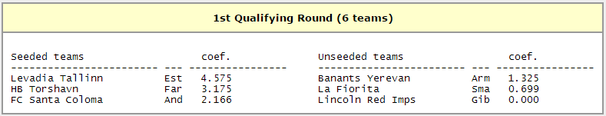
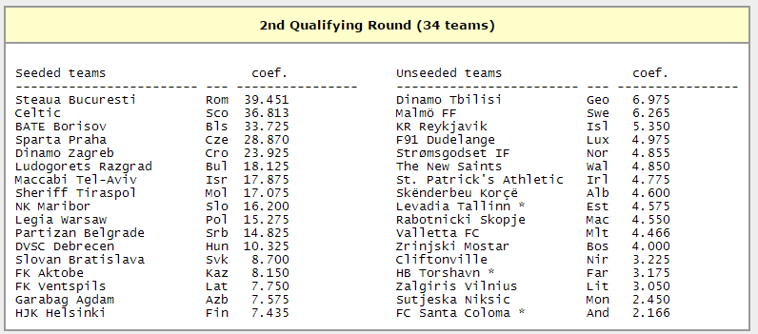
Front End (Display Screens)
Example for Team Plotted:
API checks Estonian League
Team Currently top: ‘Levadia Tallinn’
Current Team Ranking (Coefficient) checked: 4.575
Check Estonia’s Country ranking (48th) : Enter 1st Round
When all 6 teams are inserted, a sort will rank them Highest to Lowest to establish seeding.
Levadia Tallinn’s Ranking is in the top half of the 6 teams therefore are seeded.

Slide 5
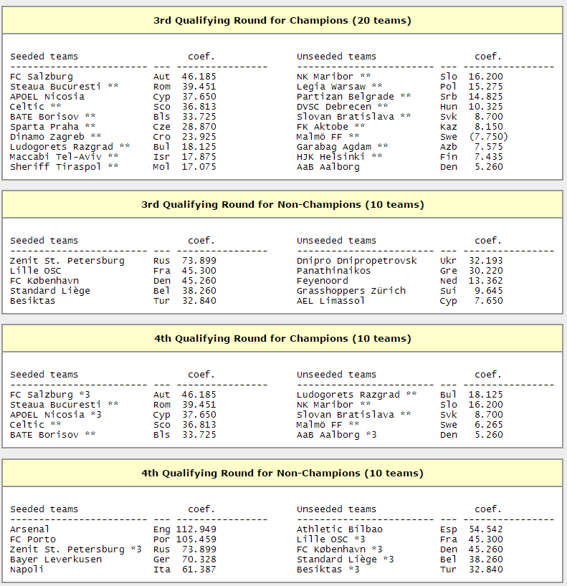

Slide 6
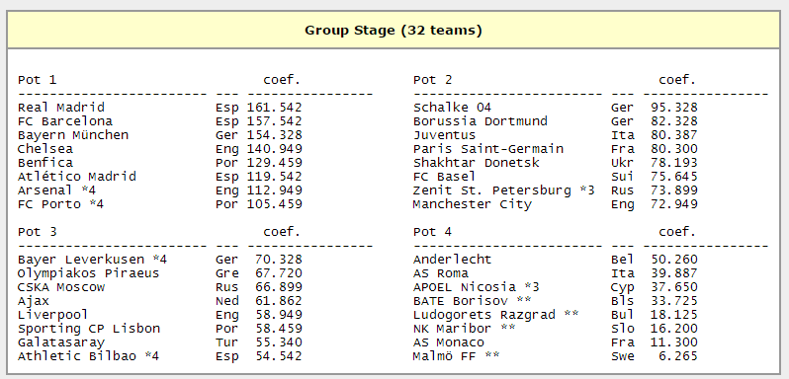

Slide 7
